Slide 1
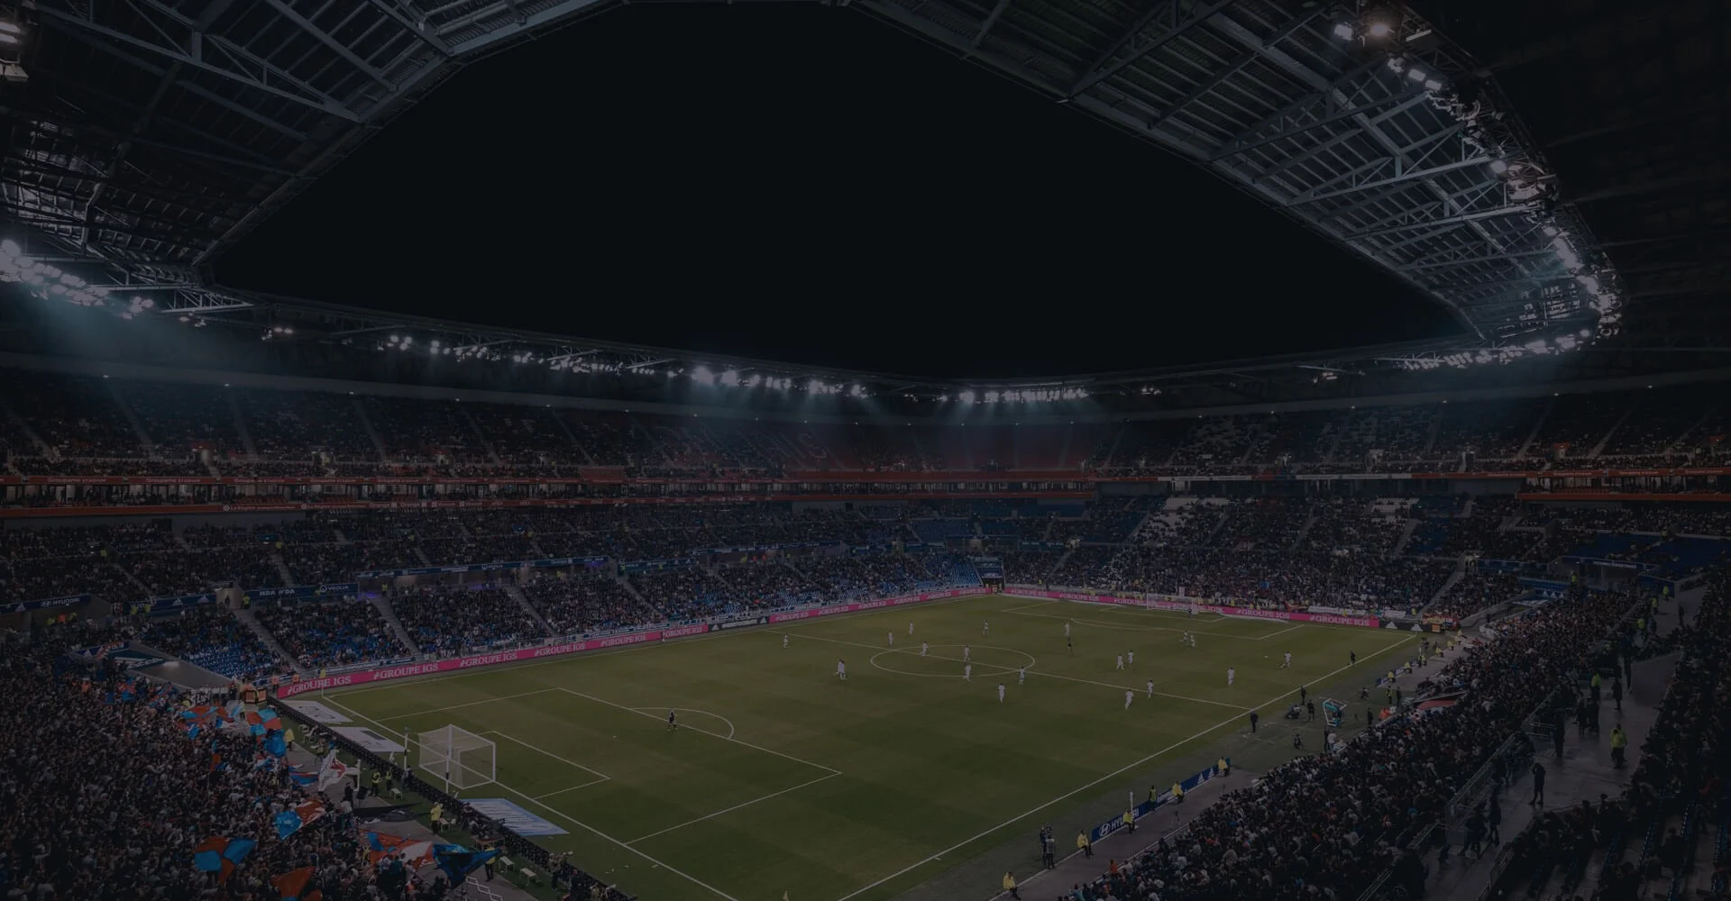
Machine Learning : A Game-Changer for Sports
Performance Analysis & Win Prediction using AI-ML
Presenter - Akshay Ugalmogale

Slide 2
Data Science & Machine Learning Use In Sports :
Player Performance Analysis
Player Valuations
Player Development
Optimize & Create Game Strategy
Win Prediction
Ticketing
Brand Material Sales Optimization
Corporate Sponsorship

Slide 3
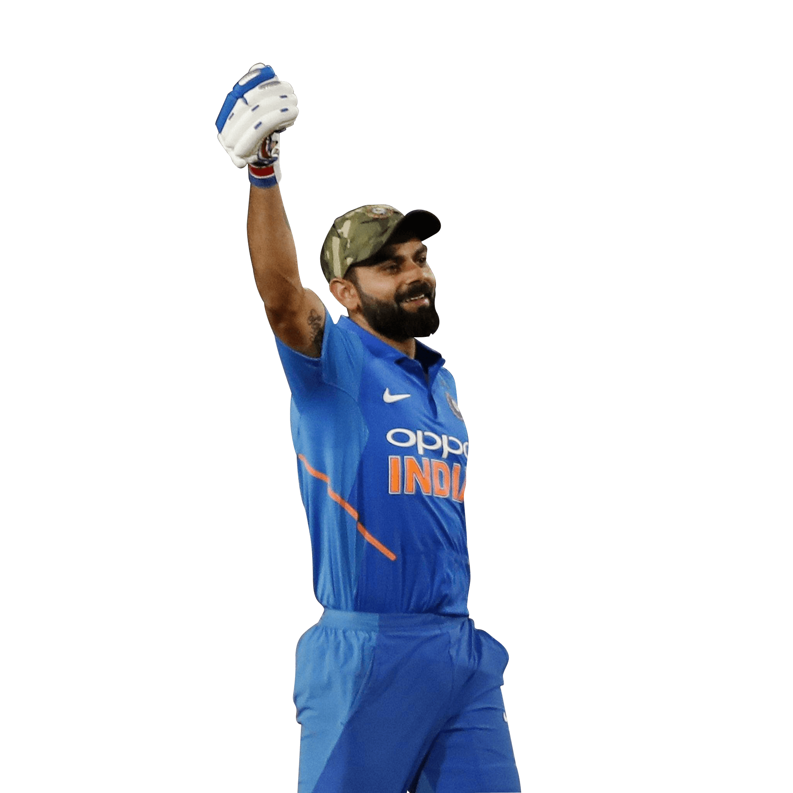
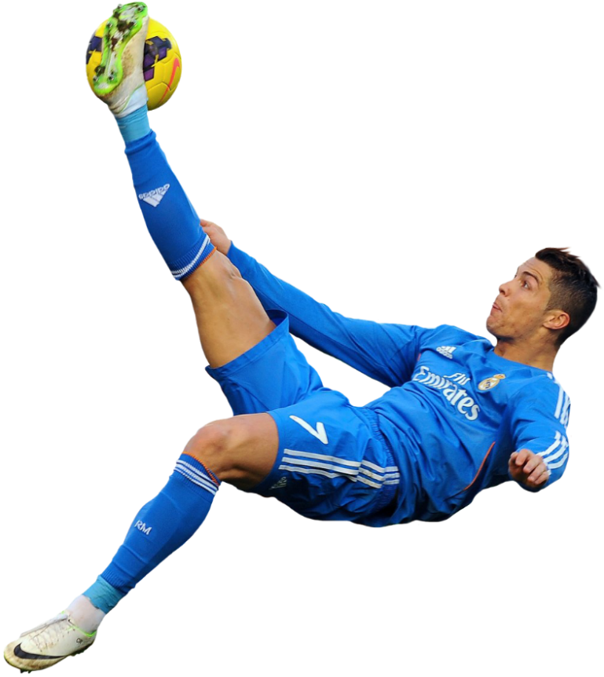
Player Performance
Future performance prediction
Enhance player development
Providing feedback to players & coaches
Predict and prevent injuries

Slide 4
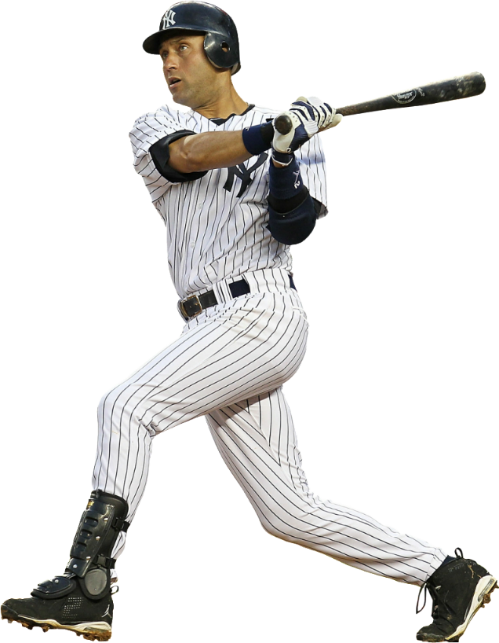
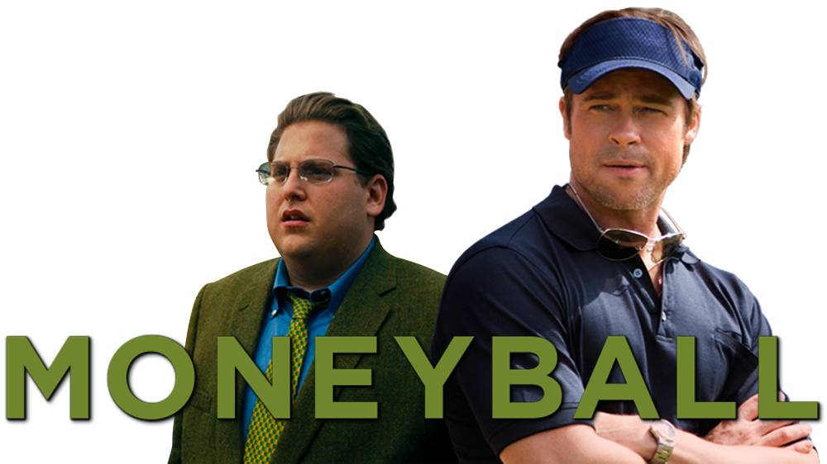
Player Valuations
Teams strive to get the best players for the lowest cost and least risk.
Accurately evaluate a player’s value along with their risks
ML can save significant money for an organization
Notes:
Moneyball is based on the real ups and downs of the 2002 baseball season. Oakland Athletics baseball team coach Billy Beane

Slide 5
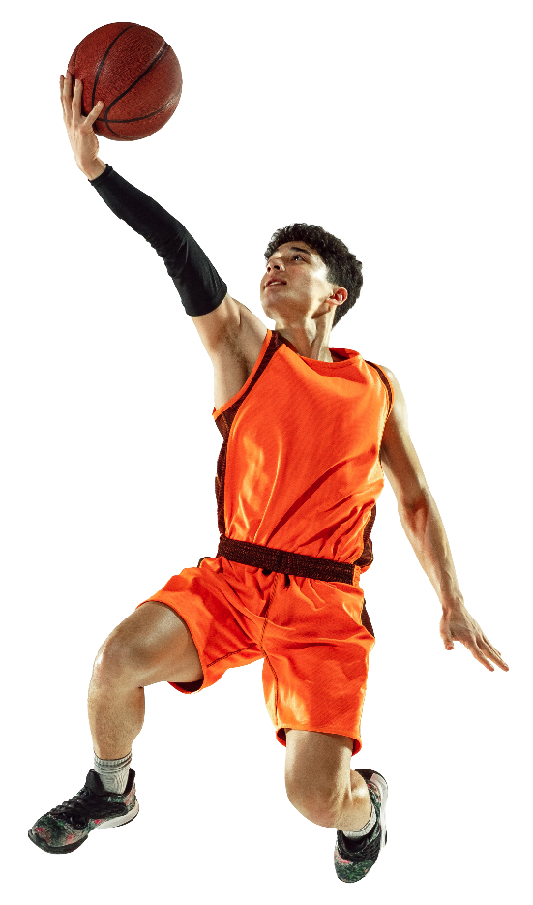
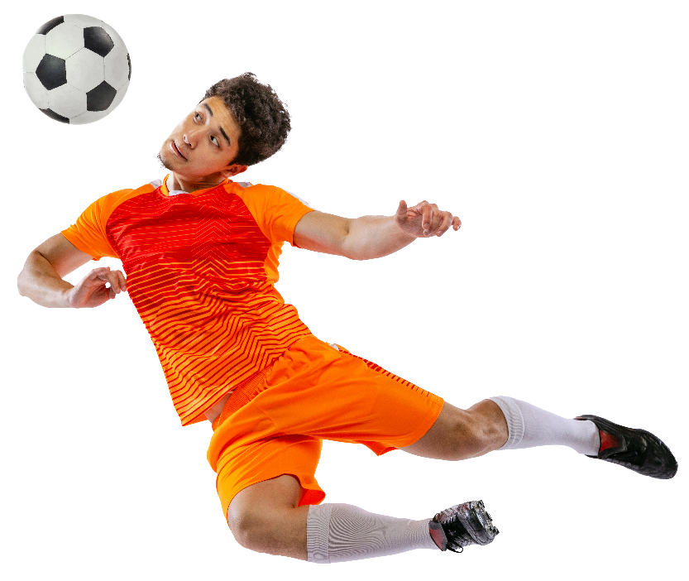
Player Development
Information to create a training strategy
Maximize a player’s future
Provide rapid feedback on a player’s game or practice performance
Help to providing proper diet

Slide 6
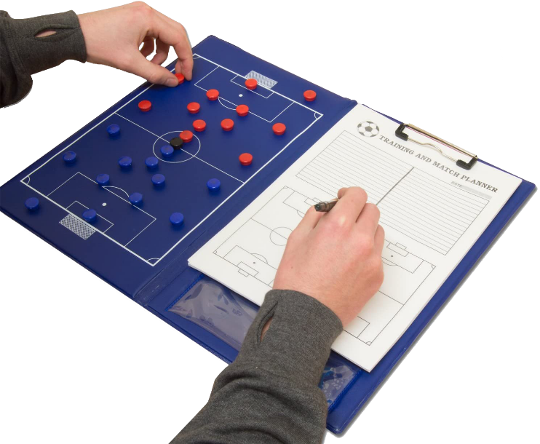
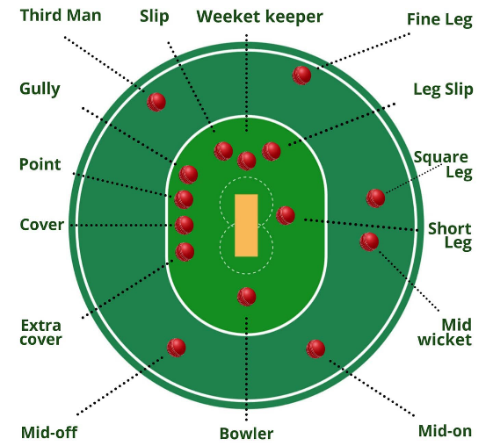
Optimize Game Strategy
Better predict the strengths, weaknesses, and tendencies of opponents.
Identifies the right strategy for each game situation.
Data science in sports can maximize your win
Offering trusted insights

Slide 7


There are many more use cases of
Data Science & ML in Sports Like-
Rules & Regulations (NRR,DLR)
Fantasy Cricket Play

Slide 8
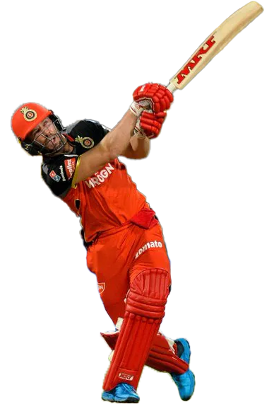
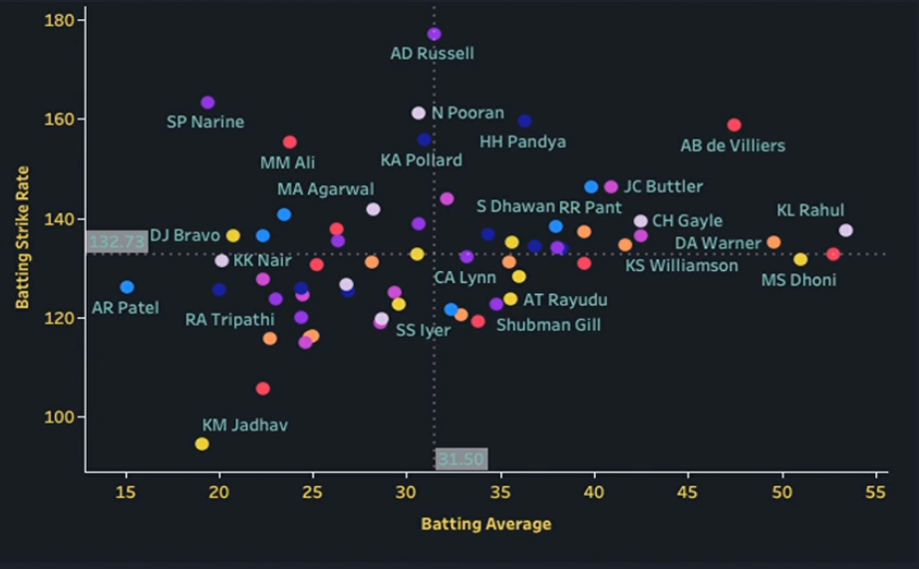
Batting Performance Analysis

Slide 9
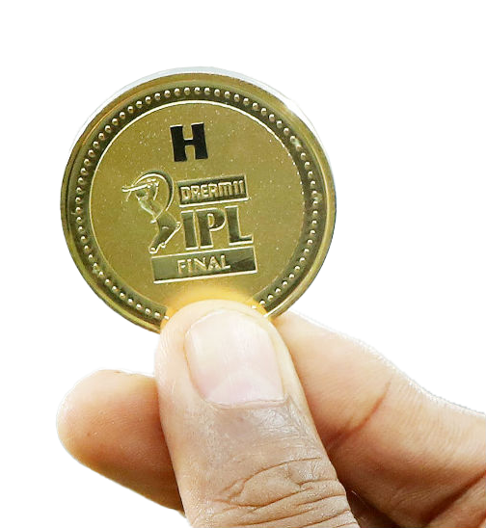

Application of AI ML
Predict winning team on the basis of toss & location using Classification Algorithms

Slide 10
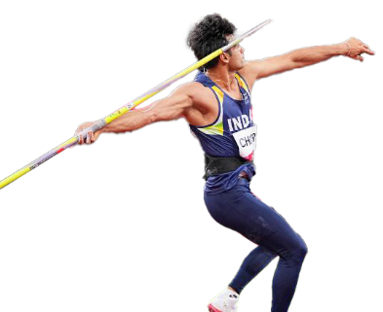
Thank You !
Dream Big !
Aim High !

